Slide 1
Java memory leak analysis
With a real use case
Andre.Simoes@criticaltechworks.com
April 2021

Slide 2
Motivation
Share some tools
Share some knowledge
Share a real example on a popular framework
Share the importance of monitoring your applications
Raise conscience about the performance impacts of memory leaks

Slide 3
Topics

Slide 4
Topics
Memory leak
Java memory model
How to detect memory leaks?
How to isolate the problem?
In-dept analysis
Get a different perspective
Live demo
What are the next steps?
Java virtual machine overview

Slide 5
Memory leak
01

Slide 6
Memory leak
From wikipedia
In computer science, a memory leak is a type of resource leak that occurs when a computer program incorrectly manages memory allocations in a way that memory which is no longer needed is not released. A memory leak may also happen when an object is stored in memory but cannot be accessed by the running code.[2] A memory leak has symptoms similar to a number of other problems and generally can only be diagnosed by a programmer with access to the programs' source code.
Because they can exhaust available system memory as an application runs, memory leaks are often the cause of or a contributing factor to software aging.
Software aging
Software aging refers to all software's tendency to fail or cause a system failure after running continuously for a certain time.

Slide 7
Memory leak
We want to avoid them
They cause failures on our applications
They are not easy to spot

Slide 8
Java memory model
02

Slide 9
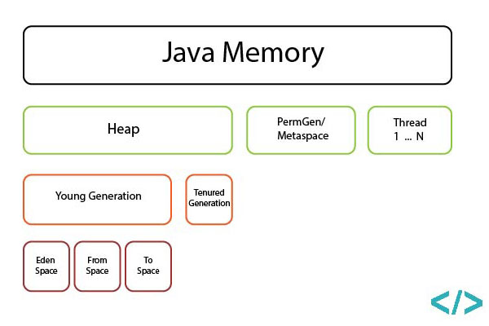
Java memory model
Java memory model
(source)

Slide 10
Java memory model
Heap Space
(Heap Memory) in java is used for dynamic memory allocation for java objects and JRE classes at the runtime. New objects are always created in heap space and the references to this objects are stored in stack memory
Young generation
where all new objects are allocated and aged
Old(Tenured) Generation
where long surviving objects are stored
Metaspace (old perm gen)
Stores class related data and is used to keep information for loaded classes and few other advanced features like StringPool

Slide 11
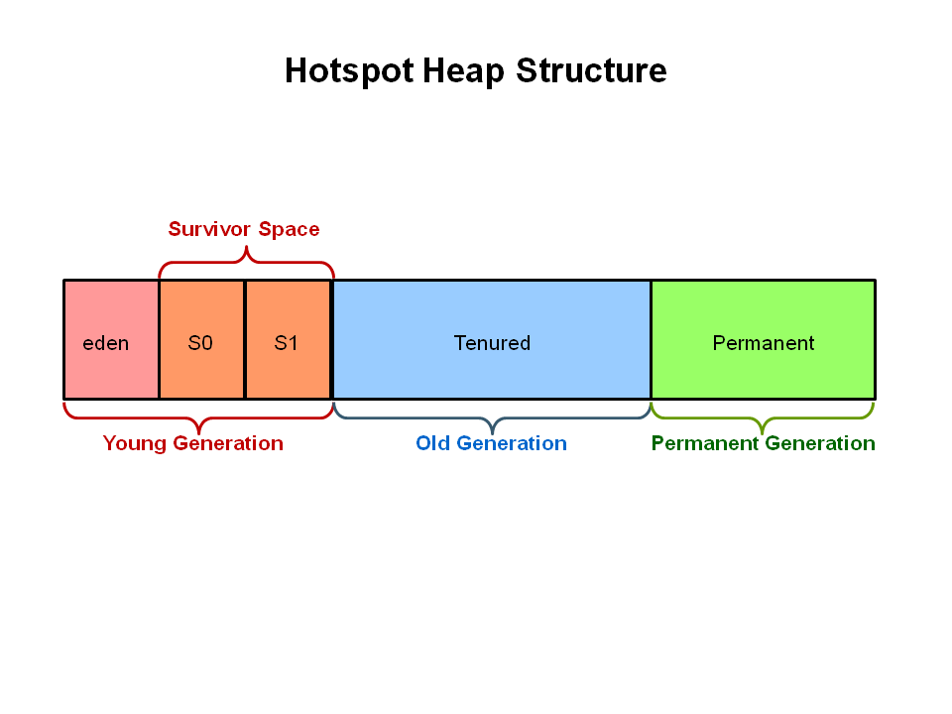
Java memory model
Garbage collector
Automatic garbage collection is the process of looking at heap memory, identifying which objects are in use and which are not, and deleting the unused objects. An in use object, or a referenced object, means that some part of your program still maintains a pointer to that object. (source)
Minor collection
Target young generation
"Stop the world" event
Fast
Major collection
Target old generation
"Stop the world" event
Slow

Slide 12
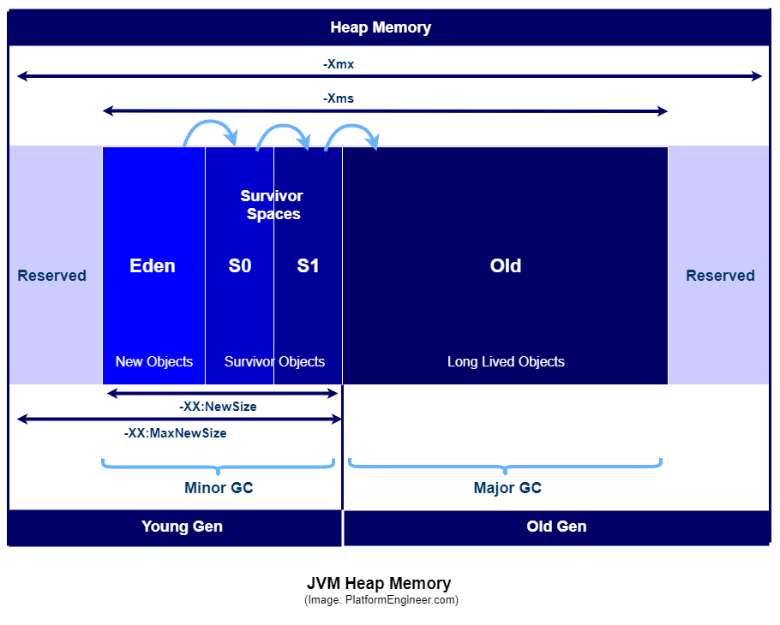
Java memory model
JVM Heap Memory (source)
Minor GC
Major GC
Adjusting parameters
What is Xms and Xmx? (source)
Xms is used to specify the initial lower bound of java heap memory size.
Default size is 1/64th of the physical memory size.
Xmx is used to specify the upper bound of java heap memory size.
Default size is 1/4th of the physical memory size.

Slide 13
How to detect memory leaks?
03

Slide 14
How to detect memory leaks?
Monitoring is the key!
You should do it on a regular basis
You must understand what are normal patterns
You must understand what are suspicious patterns
You should know how to stress your application

Slide 15
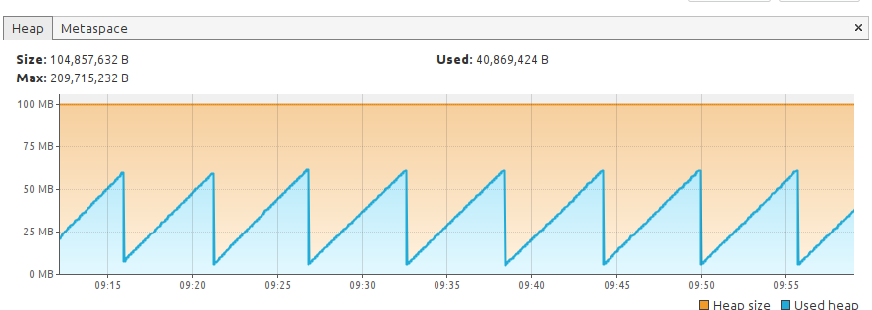
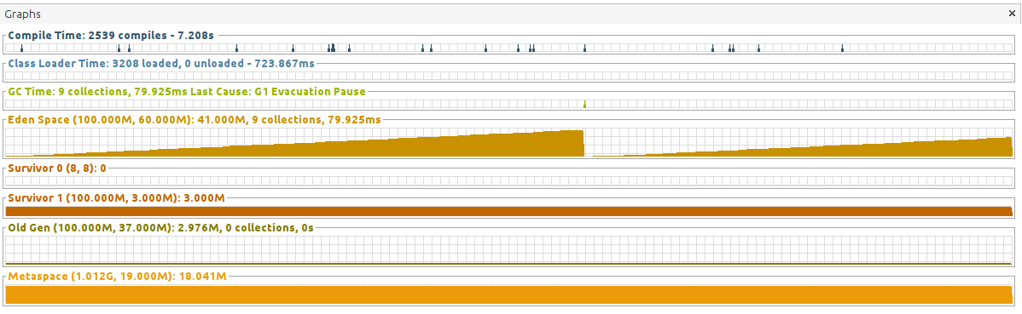
How to detect memory leaks?
Normal pattern (heap and GC times)
idle
50 min timespan

Slide 16
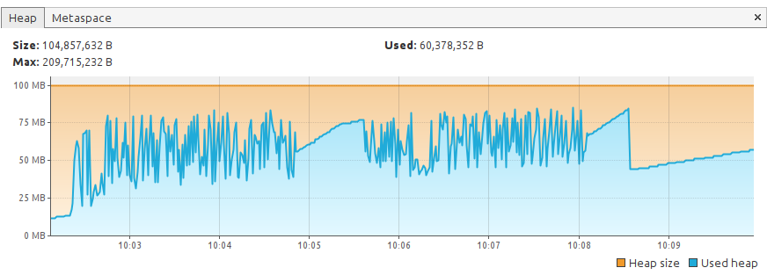
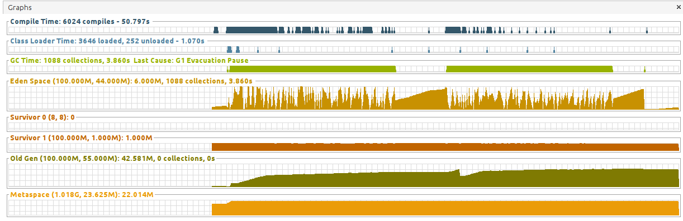
How to detect memory leaks?
Normal pattern (heap and GC times)
Heavy load
2 x 3 min load

Slide 17
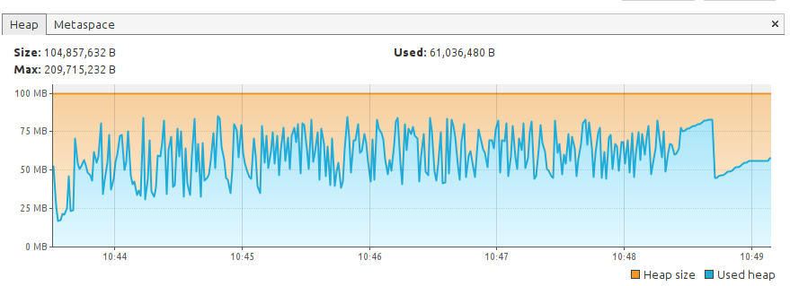
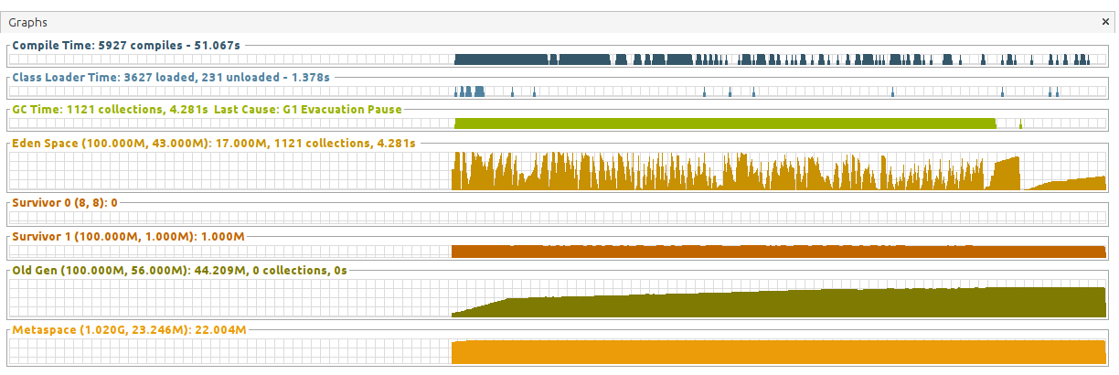
How to detect memory leaks?
Normal pattern (heap and GC times)
Heavy load
6 min load

Slide 18
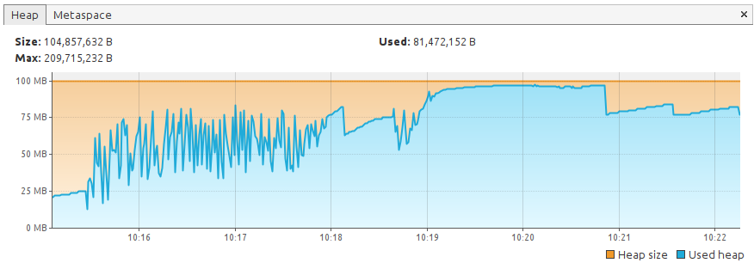
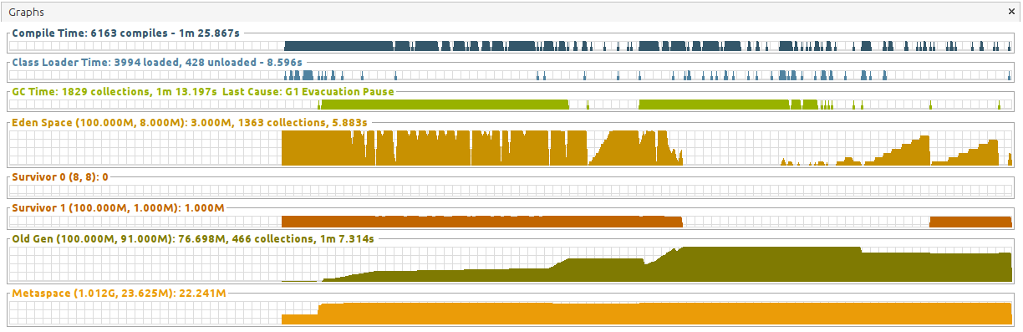
How to detect memory leaks?
Suspicious pattern (heap and GC times)
Heavy load
2 x 3 min load

Slide 19
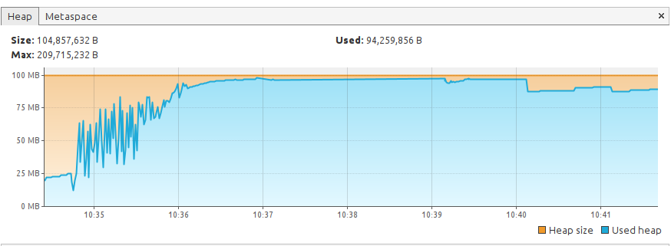
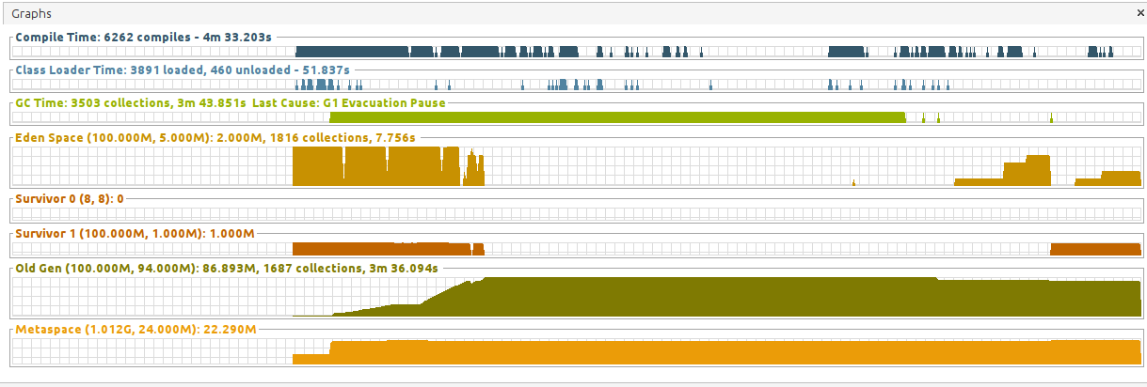
How to detect memory leaks?
Suspicious pattern (heap and GC times)
Heavy load
6 min load

Slide 20
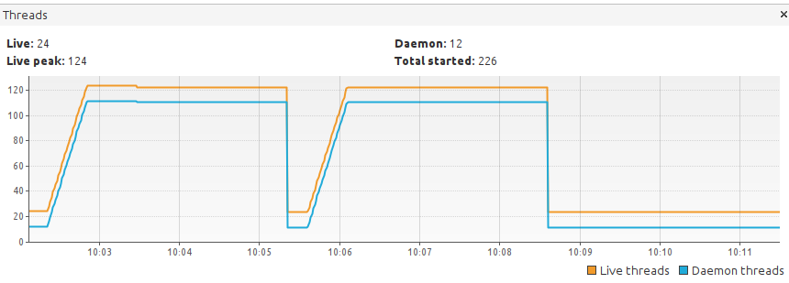
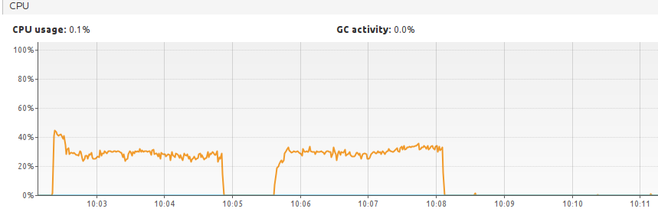
How to detect memory leaks?
Normal pattern (CPU and threads)
Heavy load
2 x 3 min load

Slide 21
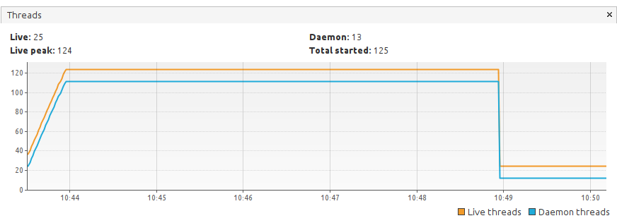
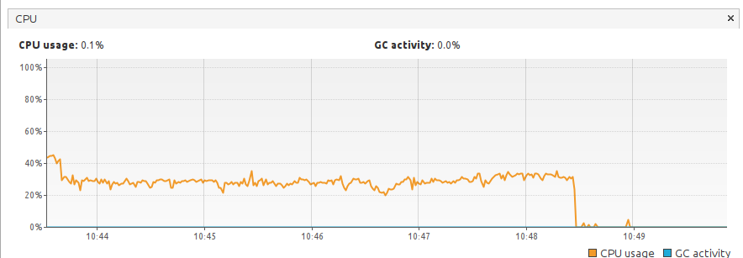
How to detect memory leaks?
Normal pattern (CPU and threads)
Heavy load
6 min load

Slide 22
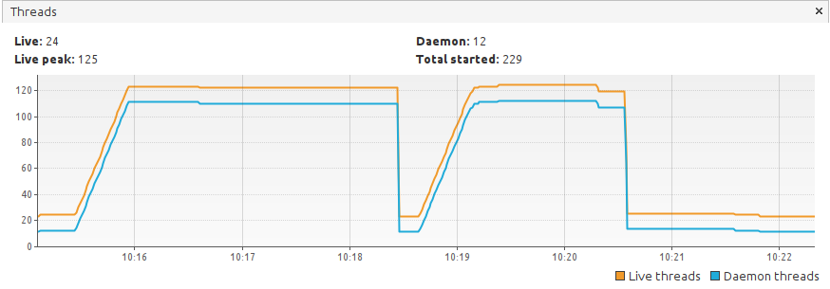
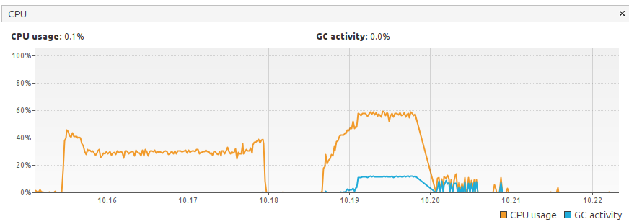
How to detect memory leaks?
Suspicious pattern (CPU and threads)
Heavy load
2 x 3 min load

Slide 23
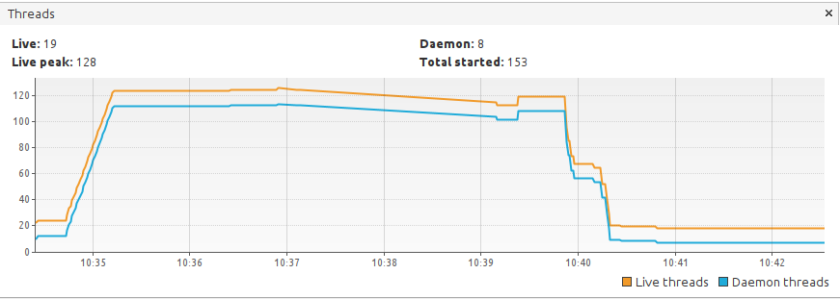
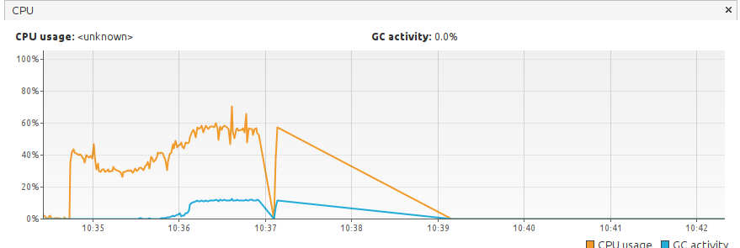
How to detect memory leaks?
Suspicious pattern (CPU and threads)
Heavy load
6 min load

Slide 24
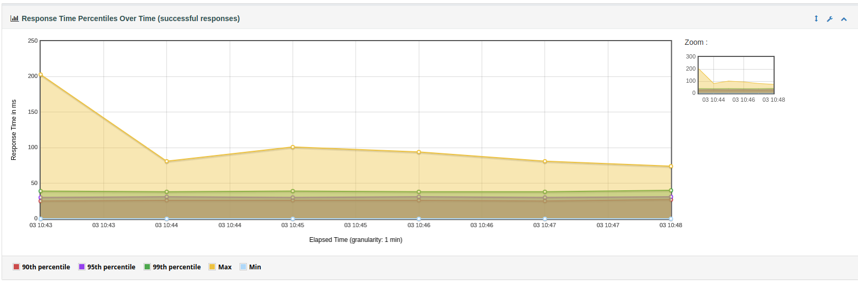
How to detect memory leaks?
Response times percentiles
6 min load

Slide 25
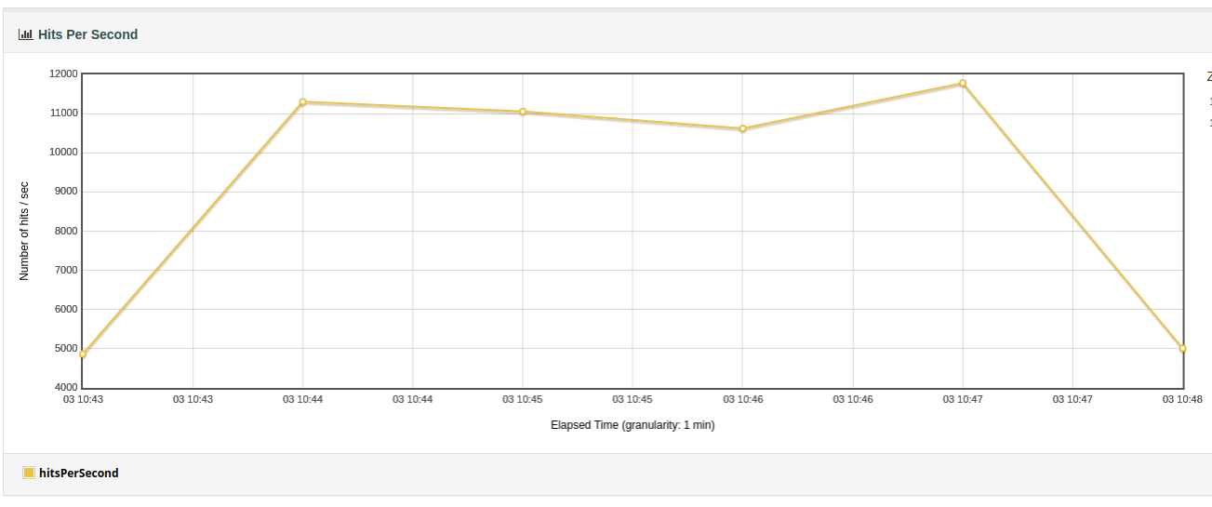
How to detect memory leaks?
Response times percentiles
6 min load

Slide 26
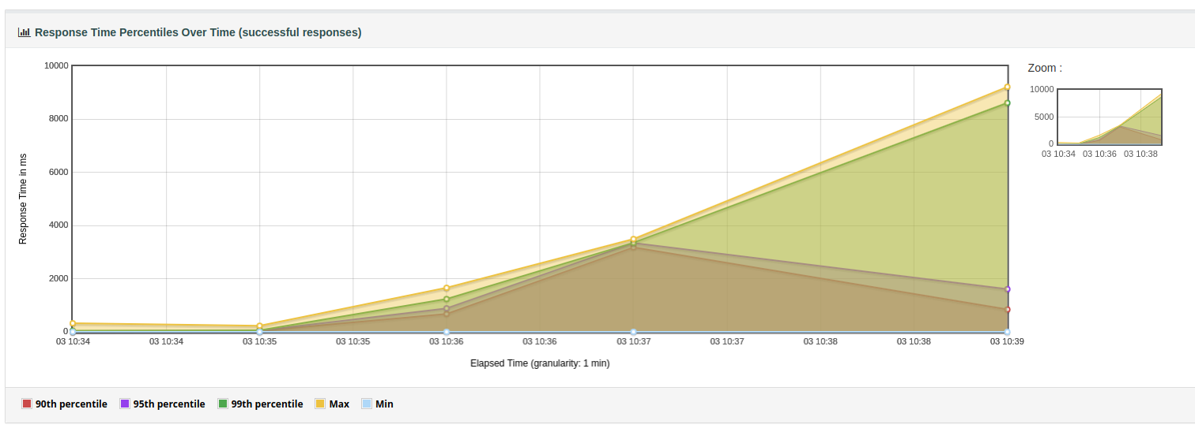
How to detect memory leaks?
Response times percentiles
6 min load
suspicious

Slide 27
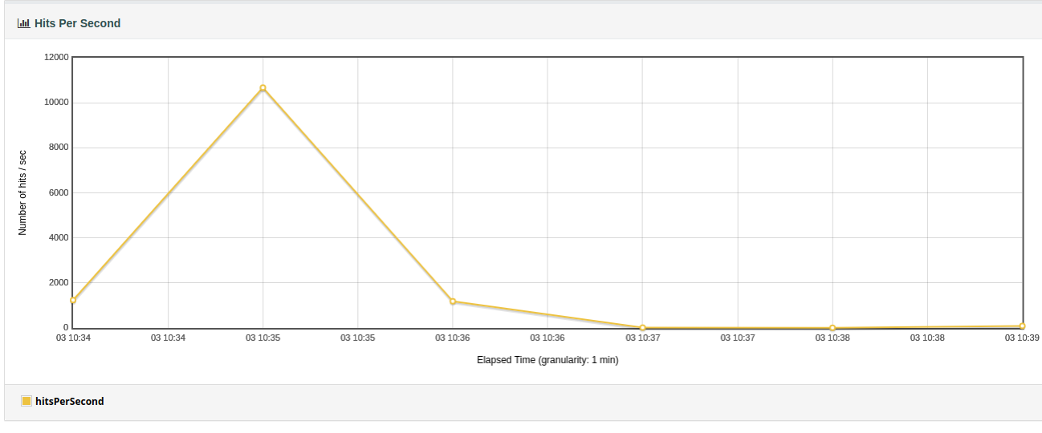
How to detect memory leaks?
Response times percentiles
6 min load
suspicious

Slide 28
How to isolate the problem?
04

Slide 29
How to isolate the problem?
Explore your code for suspicious modules
Extra care on places where you allocate a lot of resources
Extra care on concurrent or multithread access to objects
SEPIA – Picking service
Quarkus
REST
Kafka
VertX
Hazelcast
Hibernate
Interceptors
Lombok
etc...
A lot of sources for possible issues!!!

Slide 30
How to isolate the problem?
Focus at one system input at a time
Do not add unnecessary complexity
Use tools that allow you to create load on the application
We should be able to repeat the test systematically
Ex: Jmeter
Sample your application
Long living objects are always candidates!
There must be a good reason for an object to survive a full GC
Heap dump
Require extra knowledge

Slide 31

How to isolate the problem?
Apply scientific method
(source)
Establish a base of work
You have a framework to run tests
You can reproduce the problem each time you run the test
Change only one variable at a time
Run tests and checks results
Repeat until the problem disappear

Slide 32
How to isolate the problem?
Create a source of true
Always use the same test
Remove modules and repeat the test
You already removed a lot of modules and the problem is still there?
System break down
Is not easy to remove more modules
Start from the most basic application
Hello world project
Create the most basic project where your test can run
The issue is not there
Add a module at a time until...
You can reproduce the problem again!!!

Slide 33
In-dept analysis
05

Slide 34
In-dept analysis
You have found an issue
You have a test to reproduce it
You have a very basic application where the issue is present
Take a break!
Repeat test
Repeat again
Look at the code
Look at the test
Repeat again
Always the same pattern?

Slide 35
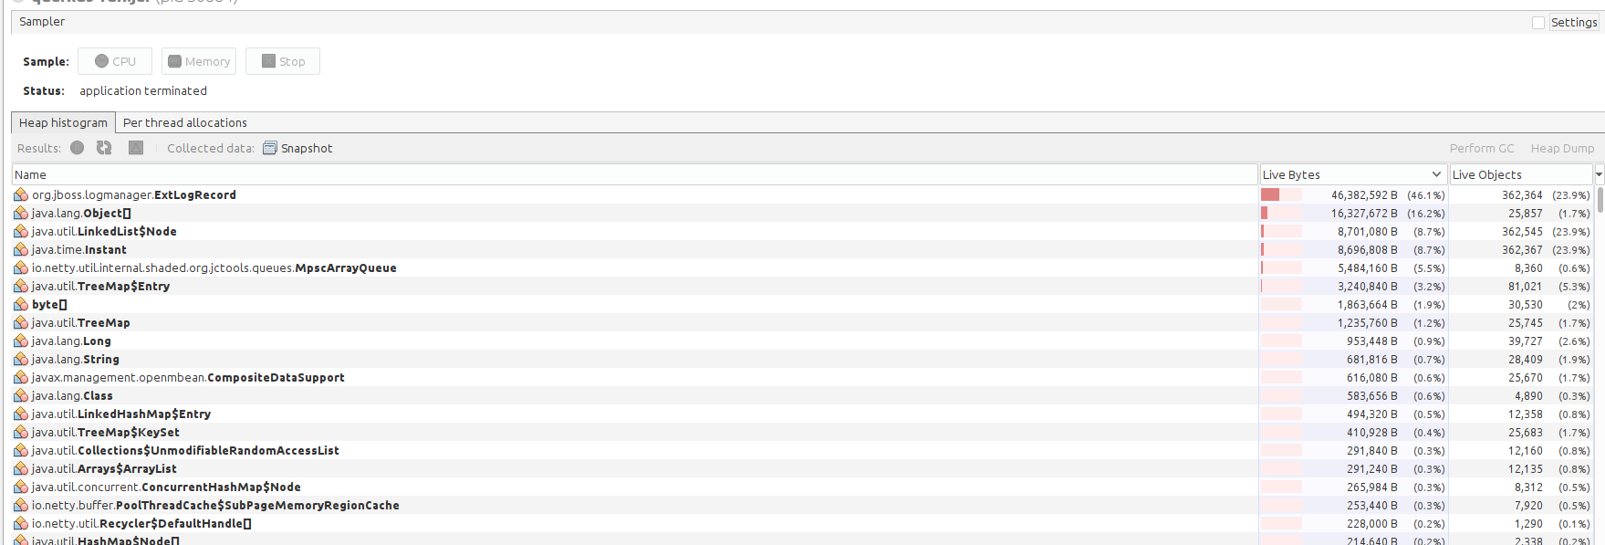
In-dept analysis
Do some heap sampling
Check for biggest live objects and bytes

Slide 36
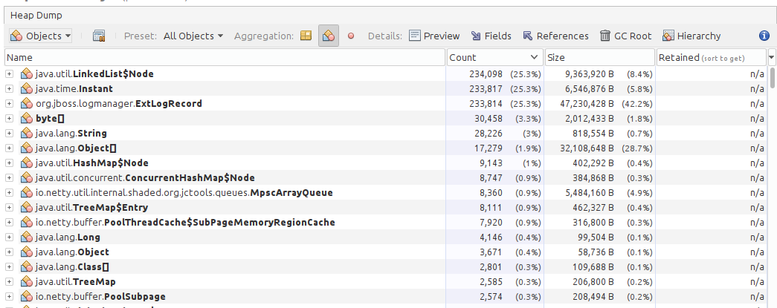
In-dept analysis
Heap dump
Sort by count

Slide 37
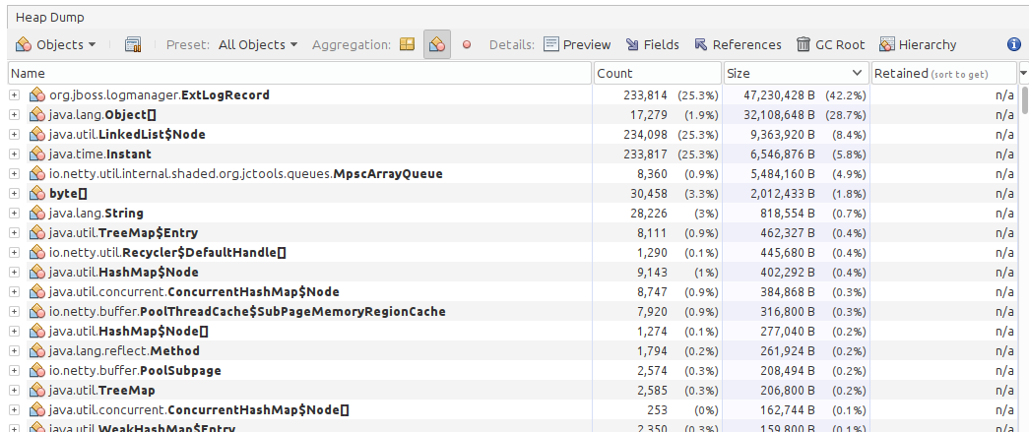
In-dept analysis
Heap dump
Sort by size

Slide 38
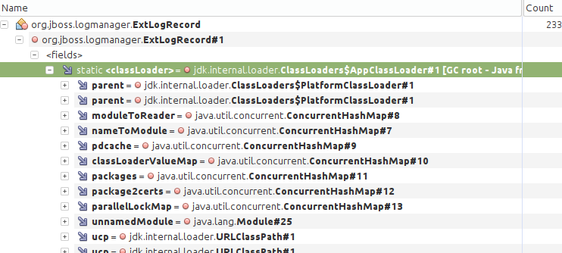
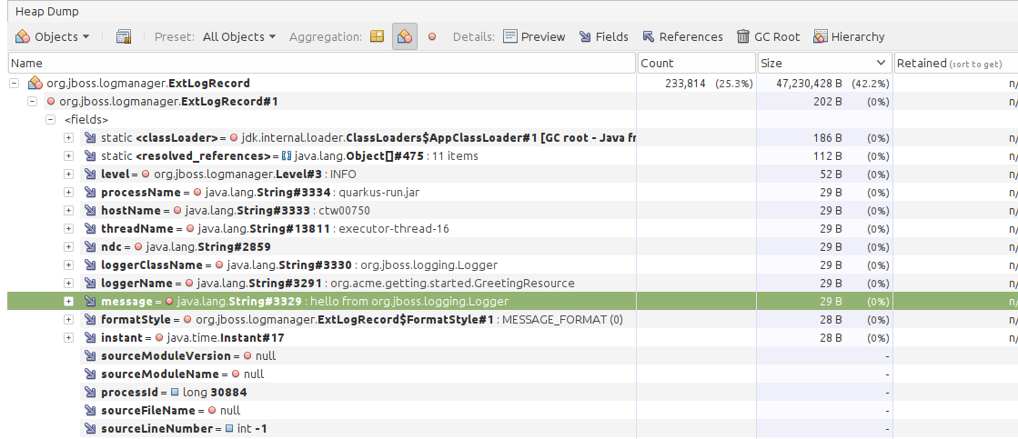
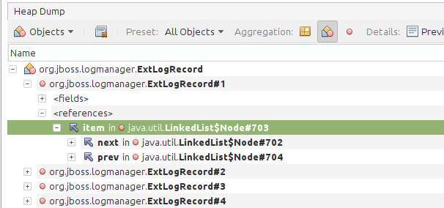
In-dept analysis
Heap dump
Explore the objects

Slide 39
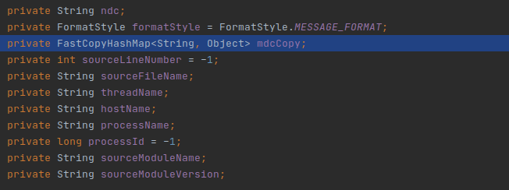
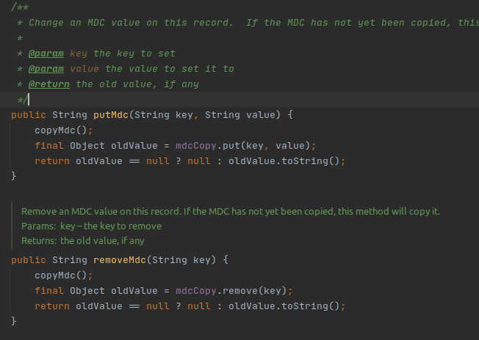
In-dept analysis
Study the source code
Check for suspicious methods
ConcurrentHashMap
Quarkus source code is available
Read the code
Debug the code
Found a reference to an HashMap
Found a dead end!
And now what?!!!

Slide 40
Get a different perspective
06

Slide 41
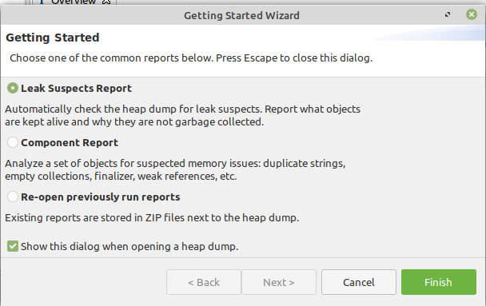
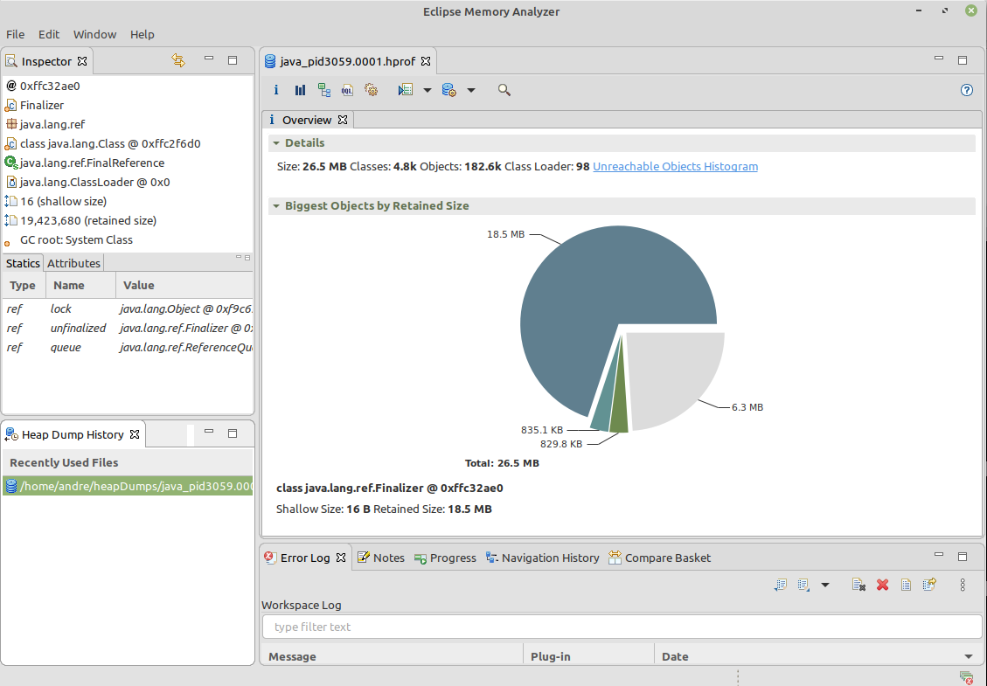
Get a different perspective
Eclipse Memory Analyzer (MAT)
(source)
A fast and feature-rich Java heap analyzer that helps you find memory leaks and reduce memory consumption.

Slide 42
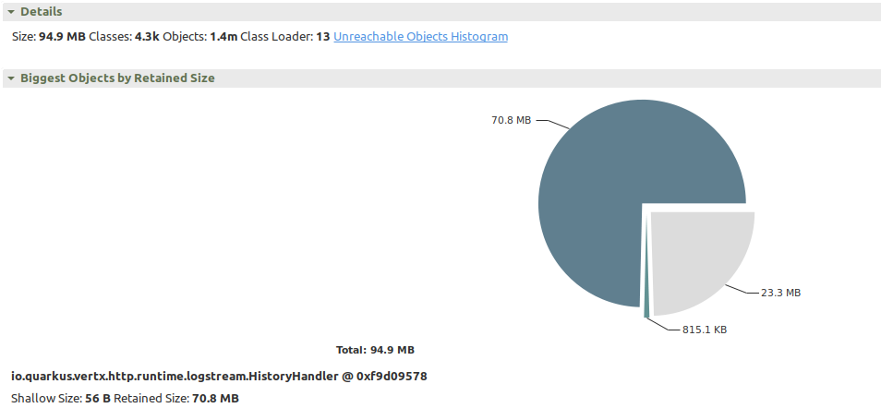
Get a different perspective
Overview

Slide 43
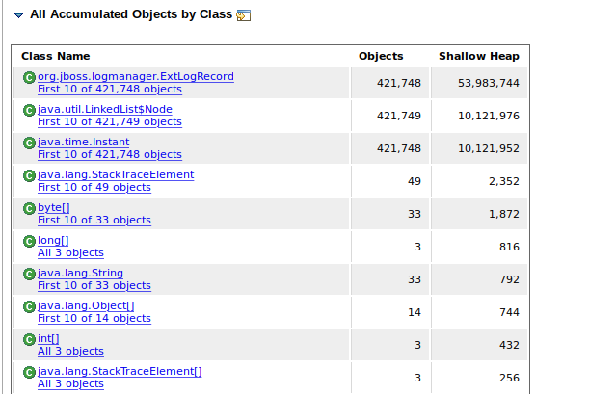
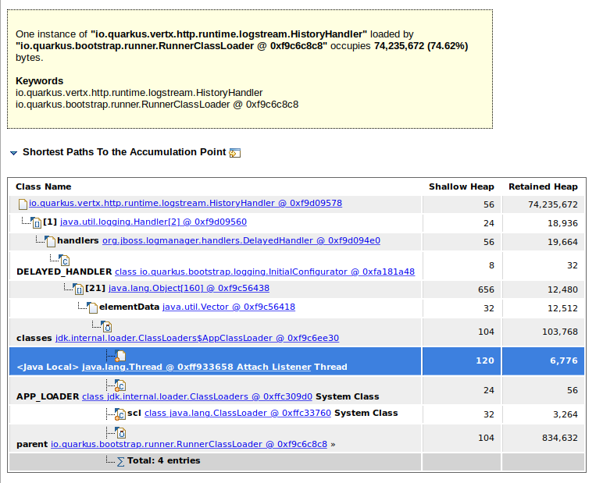
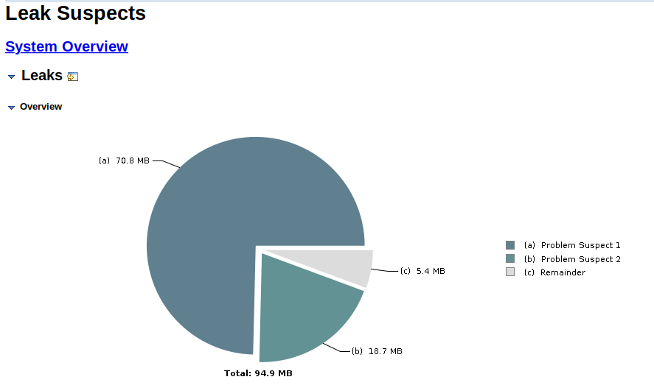
Get a different perspective
Leak suspects

Slide 44
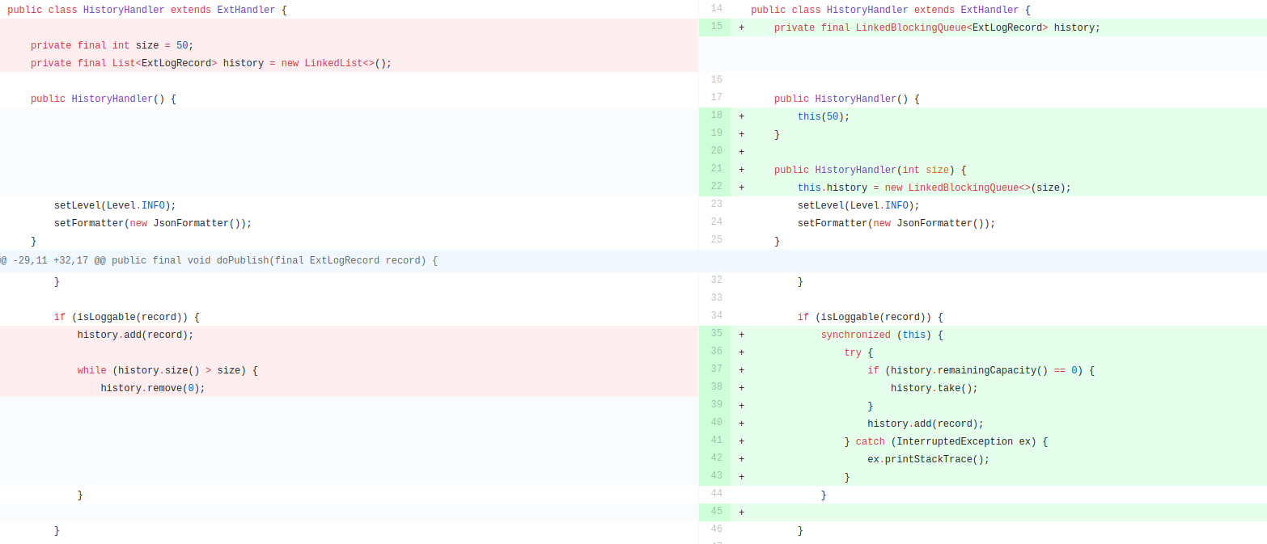


Get a different perspective
Check the oracle!!!
(source)

Slide 45
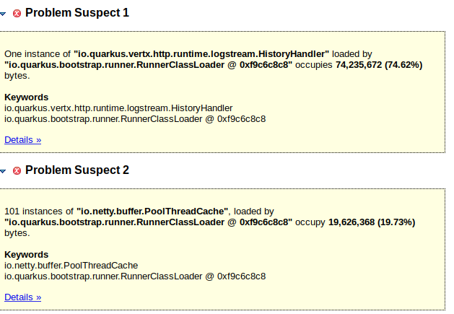
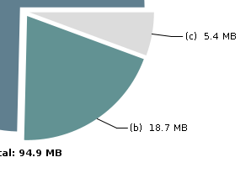
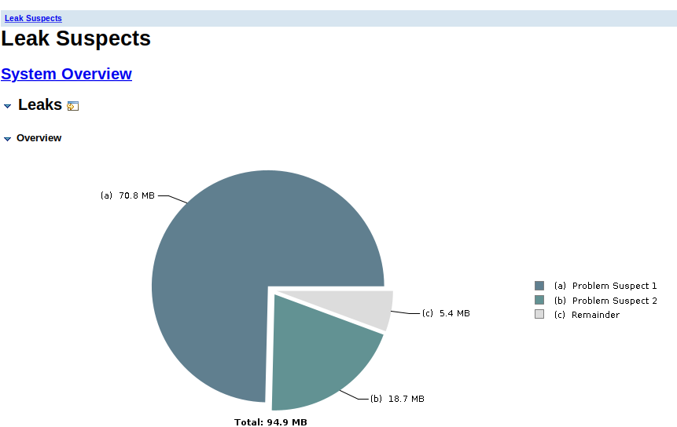
Get a different perspective
Discard possible false positives
Restrict jvm heap can lead to false positives
Always take in consideration the context where you are testing
Ex: Xms and Xmx changes

Slide 46
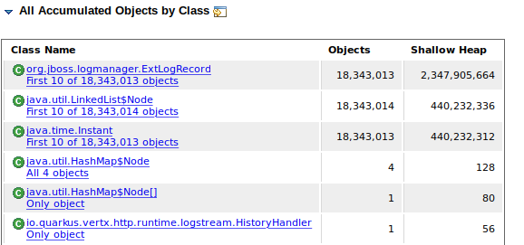

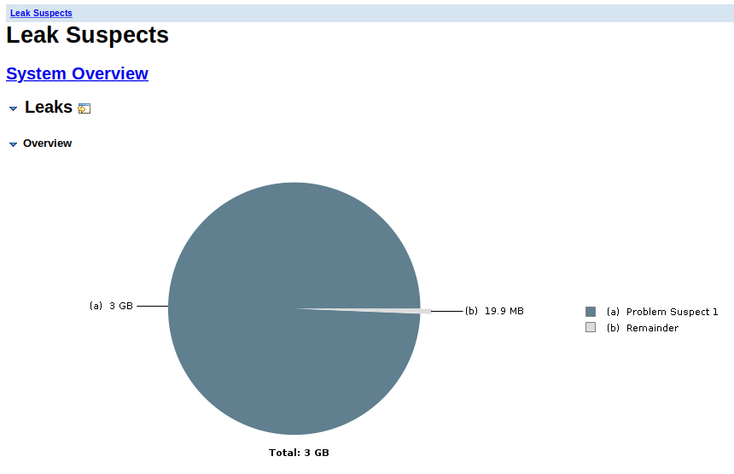
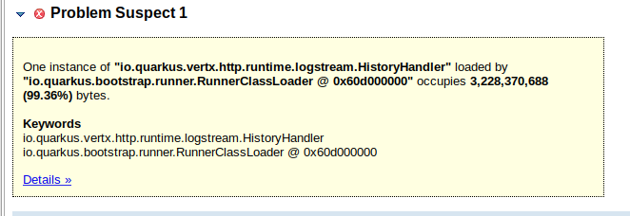
Get a different perspective
Same test results without restricting memory usage
Now you will only get one suspicious problem

Slide 47
Live demo
07

Slide 48
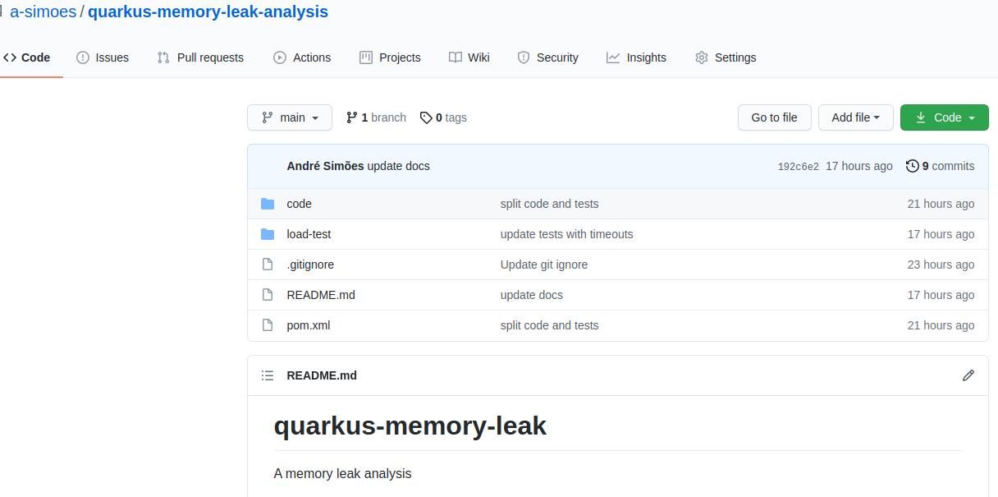
Live demo
Checkout the code at github

Slide 49
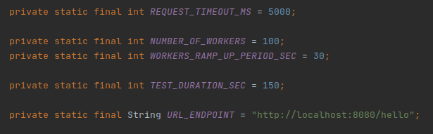
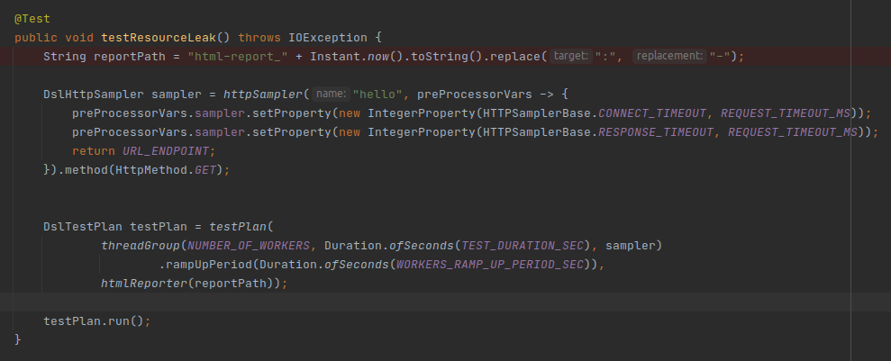
Live demo
The test method & parameters

Slide 50
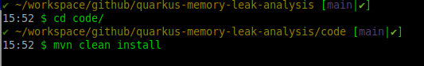

Live demo
Compile the sources
Start the application

Slide 51



Live demo
Open visualvm
Select your application
Run the test

Slide 52

Live demo
Compile again with issue fixed version
Start the application
Select your application on visualvm
Run tests

Slide 53
What are the next steps?
8

Slide 54
What are the next steps?
Did you find this presentation helpful?
Did you think we must share this subject with others?
What can I improve for next time?
Questions?

